Slide 1
Competitive Sentiment Analysis Using Character Level CNNs with Limited Data
Md. Toha Siddique | Zahidul Islam Rabbi
Supervised By, Sadman Sadik Khan

Slide 2
CONTENTS OF THIS PRESENTATION
INTRODUCTION | MODEL ARCHITECTURE
RELATED WORKS | TRAINING APPROCH
DATASET & PREPROCESSING | EXPERIMENTS
 | RESULTS & DISCUSSION

Slide 3
01
INTRODUCTION
Why Sentiment Analysis?: Classifies opinions in text (e.g., Yelp reviews: positive or negative).
Character-Level CNNs: Process raw text directly, no complex preprocessing needed.
Benchmark: Zhang et al. (2015) achieved 95.07% accuracy on Yelp Polarity with 598,000 samples, using thesaurus augmentation.
Our Challenge: Can we match this with just 76,076 samples (~1/8th the data), no external tricks?

Slide 4
02
RELATED WORKS
Kim et al.: Character CNNs for language modeling, not classification.
Conneau et al.: Deep CNNs (29 layers), 91.30% on IMDb, but needed more data. Dataset size 500,000.
Liu et al.: Hybrid char-word CNNs, 90.50% on AG News (120,000 samples).

Slide 5

03
DATASET & PREPROCESSING
Source: Yelp Academic Dataset, 200,000 reviews trimmed to 76,076 for balance.
Labels:≤2 stars → Negative (0).2 stars → Positive (1).
Balancing: 38,038 positive + 38,038 negative reviews.
Split: 60,860 training, 15,216 testing (80:20, random seed 42).
Text Encoding:
Fixed 1014-character sequences.
70-character alphabet (lowercase, digits, punctuation, space, newline). Padded short reviews, truncated long ones.

Slide 6
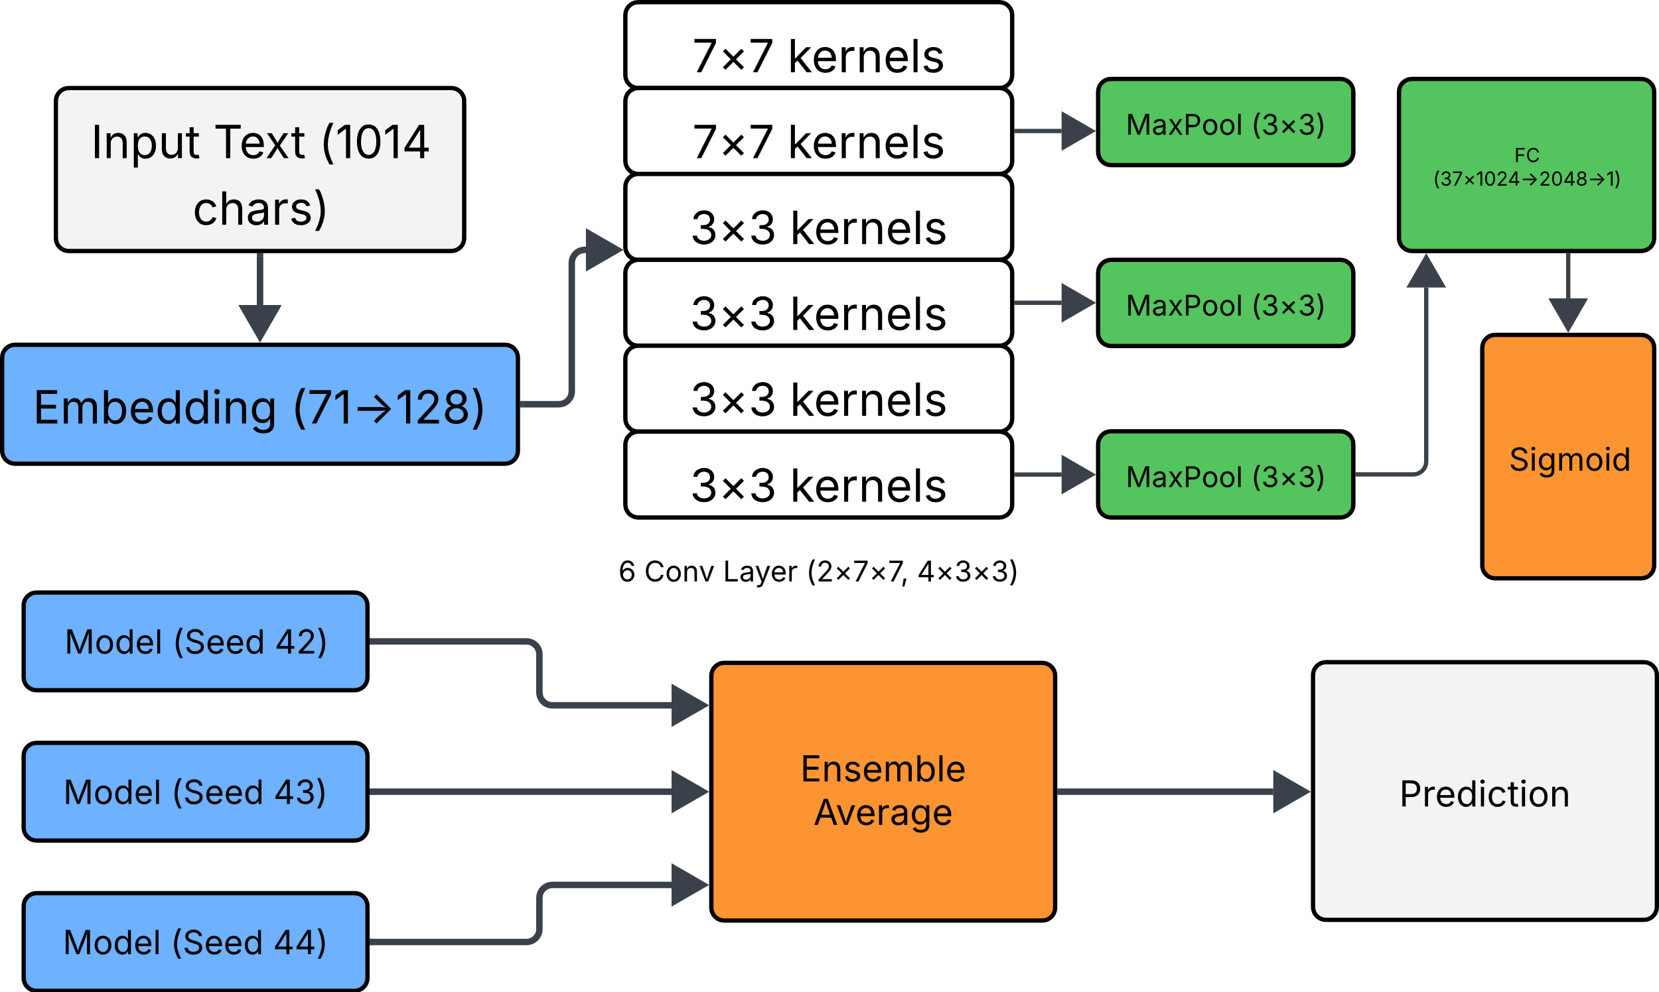
MODEL ARCHITECTURE
Enhanced CharCNN: Built on Zhang’s Large ConvNet, optimized for limited data.
Embedding Layer:
Maps 71-character vocab to 128 dimensions (up from baseline).
Captures richer text patterns.
Convolutional Stack:6 layers: 1024 filters each.
Layers 1-2: 7x7 kernels, max-pool (3x3).
Layers 3-6: 3x3 kernels, pooling after 3, 5, 6.
ReLU activation for non-linearity.
Fully Connected Layers:2048→2048→1 neurons. Dropout (0.5) to reduce overfitting.
Output: Sigmoid for binary classification (positive/negative).

Slide 7
TRAINING APPROACH
OPTIMIZER
LOSS
REGULARIZATION
Adam (learning rate = 0.001, weight decay = 10⁻⁵) for fast convergence.
Binary cross-entropy
with logits for stable classification.
Dropout (0.5) in FC layers. Weight decay to penalize large weights. Early stopping after 3 stagnant epochs.
LEARNING RATE
ENSEMBLE
SETUP
Halved every 3 epochs for stability.
Trained 3 models (seeds 42, 43, 44). Averaged sigmoid outputs for predictions.
PyTorch, NVIDIA P100 GPU, batch size 64

Slide 8
FLOWCHART
TRAINING PIPELINE
DATA
MODEL
ADAM
LOSS
REGULARIZATION
ENSEMBLE
OUTPUT

Slide 9
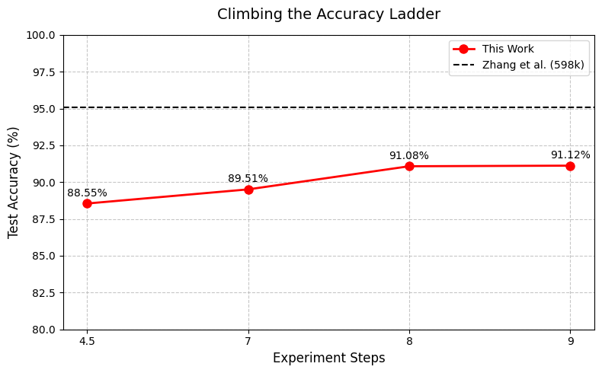
EXPERIMENTS
Initial Run:
50,000 samples (40,000 train, 10,000 test).
Accuracy: 88.55%, hit by overfitting.
Scaled Run:
76,076 samples (60,860 train, 15,216 test).
Single model: 91.08% accuracy.
Ensemble Run:
3 models (seeds 42, 43, 44).
Combined for 91.12% accuracy.
Setup:
Adam optimizer, early stopping (3 epochs).
Learning rate halved every 3 epochs.
Ran on NVIDIA P100 GPU, PyTorch.
Goal: Test model robustness with limited data.

Slide 10
RESULTS AND DISCUSSION
MODEL | ACCURACY | PRECISION | RECALL | F1 SCORE
Single | 91.08% | 92.07% | 90.02% | 91.04%
Ensemble | 91.12% | 89.86% | 92.83% | 91.32%
Zhang et al. | 95.07% | - | - | -
Success: 91.12% with 1/8th Zhang’s data shows model efficiency.
Challenge: Overfitting persists (e.g., accuracy dips from 91.20% to 89.68%).
Ensemble: +0.04% gain suggests similar model outputs.
No augmentation: Relied on raw model power, unlike Zhang’s +0.58% boost.
Impact: Practical for data-scarce sentiment analysis tasks.

Slide 11
THANKS!
Please keep this slide for attribution

